Slide 1
External Styling

Slide 2
Agenda
External Styling
Sample output
External Styling implementation

Slide 3
External Styling
Used to separate HTML and CSS code.
Same CSS file can also be used in multiple files.
Separation of HTML and CSS code will let developers build the code faster and easily.
Syntax to add CSS file in HTML file
<link rel="stylesheet" href="External_Style.css"/>
rel = “stylesheet” will let html know that the link provided is a CSS file
href = “link to the file here”
If the css file is in the same file of your current html file,
then just specify the file name as shown above.

Slide 4

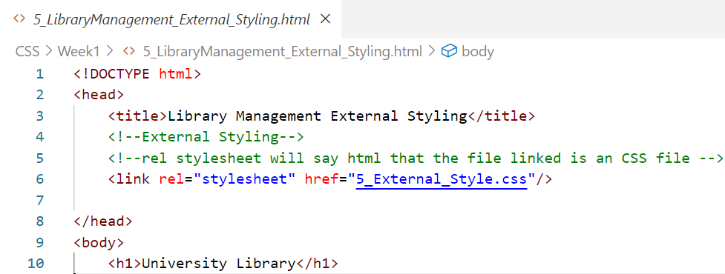
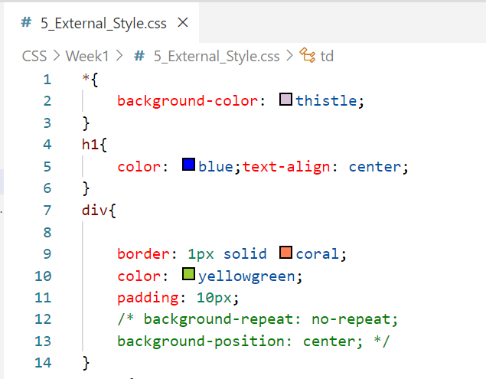
Sample output

Slide 5
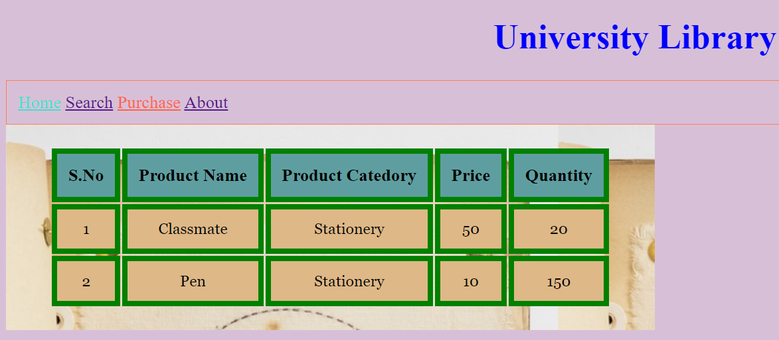
Sample output
Notes:
https://wordpress.org/openverse/photos/36d18951-82ca-4ae9-9f6e-60582cdc7ac0

Slide 6
External Styling implementation
Lets see how to implement external styling.

Slide 7
Summary
External styling is used to separate css and html code.
Can use the same CSS file in multiple html files.
DO NOT WRITE ANYTHING
HERE. LEAVE THIS SPACE FOR
WEBCAM

Slide 8
Thank You
Proprietary content. ©Great Learning. All Rights Reserved. Unauthorized use or distribution prohibited

